Slide 1

Strategic Churn Analysis
Data-Driven Retention Strategy & Predictive Insights Capstone Project: Real-World Business Analysis

Slide 2
Executive Summary
→
Retention Crisis: Current churn rate of 10.6% indicates a direct threat to annual recurring revenue stability.
→
Primary Driver: Contract commitment is the strongest negative correlation (-1.25 impact), with Month-to-Month users at extreme risk.
→
Early Attrition: Tenure correlation (-0.51) confirms that customers are leaving within the first 6 months of onboarding.
→
Predictive Power: Implementation of Logistic Regression achieved 95% accuracy, enabling proactive risk intervention.
→
Strategic Mandate: Migrate high-risk segments to annual plans and optimize digital payment gateways to reduce friction.

Slide 3
Part I: Business Problem
Understanding the context and scope of attrition.

Slide 4

Current Churn Status
Loyal Base (89.4%)
Churned (10.6%)
A loss of 53 customers out of 500 signals a critical need for targeted retention strategies.

Slide 5
Part II: EDA Insights
Identifying patterns and correlations in customer behavior.

Slide 6

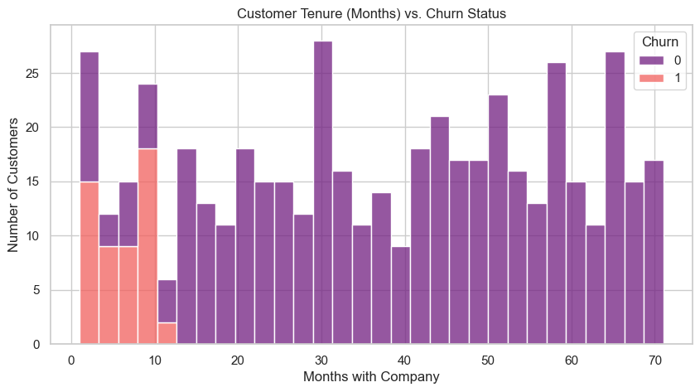
The Loyalty Gap
Tenure vs. Attrition
Correlation Analysis: -0.51
The data reveals a strong negative correlation between tenure and churn. Customers in their first 6 months exhibit the highest flight risk, suggesting that the initial onboarding experience is the primary bottleneck for long-term retention.

Slide 7
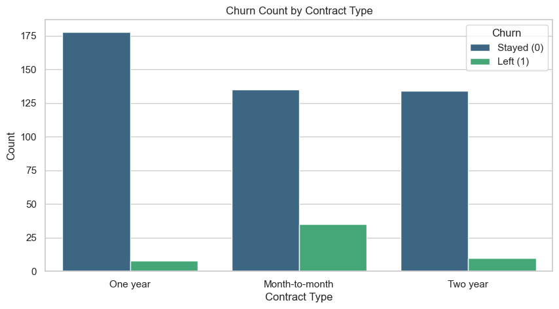
The Price Trap
Correlation Analysis: +0.11
Higher Monthly Charges correlate with increased churn density. Analysis shows a "breaking point" where price sensitivity outweighs perceived service value, particularly for non-contracted users.

Slide 8






Categorical Drivers
Contract Type
Payment Friction
Digital Proxies
Month-to-month contracts are the #1 predictor of churn. Migrating to annual plans acts as a "safety net" for retention.
Electronic Check methods show higher risk (+0.50), likely due to payment failure rates or lack of "set-and-forget" automation.
Paperless billing users churn more often, representing a segment that is tech-savvy but less "brand-sticky" than traditional users.

Slide 9
Part III: Advanced Analysis
Quantifying impact through Logistic Regression modeling.

Slide 10
Model Performance
95%
Reliable Prediction
Our Logistic Regression model successfully predicts churn with 95% accuracy. More importantly, the 0.88 Recall score means we identify nearly 90% of actual churners before they leave, providing a massive window for intervention.
ACCURACY SCORE

Slide 11
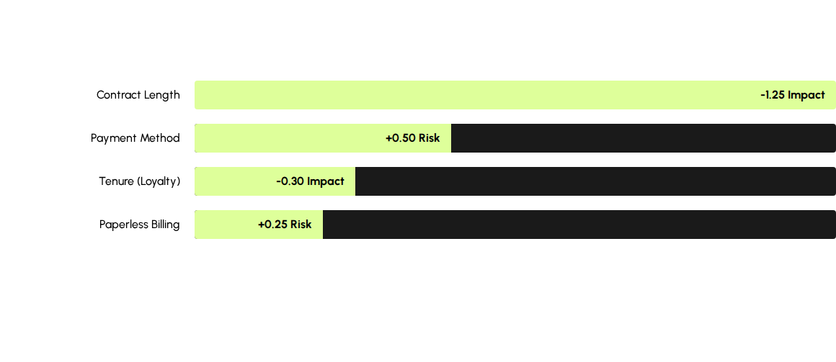
Feature Importance
Mathematically, upgrading a contract is the single most effective lever for reducing churn probability.

Slide 12
Part IV: Strategic Roadmap
Translating data into actionable business results.

Slide 13

Top Strategic Interventions
1. Contract Migration
2. High-Touch Onboarding
Launch targeted campaigns to move Month-to-Month users to Annual plans. Offer a one-time "Loyalty Credit" for switching.
Implement a 90-day "Welcome Sequence" for new customers to combat the high early-stage attrition identified in the Tenure analysis.

Slide 14
Implementation Roadmap
Days 1-30
Days 31-60
Days 61-90
Year 1
CRM Integration Deploy risk scoring model to flag high-risk customers.
Migration Pilot Launch annual plan promotion for Electronic Check users.
Gateway Audit Resolve technical friction in payment processing systems.
Scalable Growth Monitor churn reduction and optimize model features.

Slide 15
THANK YOU

